Slide 1


Customer Retention case study
A case study from Indian e-commerce customers

Slide 2
ABOUT THE CASE STUDY.
This is a case study from Indian e-commerce customers related to E-retail factors for customer activation and retention:
Customer satisfaction has emerged as one of the most important factors that guarantee the success of online store; it has been posited as a key stimulant of purchase, repurchase intentions and customer loyalty. A comprehensive review of the literature, theories and models have been carried out to propose the models for customer activation and customer retention. Five major factors that contributed to the success of an e-commerce store have been identified as: service quality, system quality, information quality, trust and net benefit. The research furthermore investigated the factors that influence the online customers repeat purchase intention. The combination of both utilitarian value and hedonistic values are needed to affect the repeat purchase intention (loyalty) positively. The data is collected from the Indian online shoppers. Results indicate the e-retail success factors, which are very much critical for customer satisfaction.

Slide 3


EXPLORATORY DATA ANALYSIS (EDA)
Exploratory Data Analysis (EDA) is an approach to analyze the data using visual techniques. It is used to discover trends, patterns, or to check assumptions with the help of statistical summary and graphical representations.
Before EDA the data is downloaded and has been called using essential libraries for the purpose of visualization and analysis.

Slide 4

How to do EDA
These are certain steps that are to be performed in EDA:-
Downloading the dataset.
Observe your dataset.
Find any missing values or the null values.
Find the shape of your dataset.
Organizing a dataset.
Understanding variables.
Visual representation of the data for better understanding using seaborn and matplotlib libraries.
Describing the data.
Identify relationships (correlation) in your dataset.

Slide 5
EDA
Before EDA the data is downloaded and has been called using essential libraries for the purpose of visualization and analysis in the variable (df).
Then the shape is found using the required code which is 269 rows and 71 columns.
Then the null values present in the data is found using the required code which comes to be 0 that is there are no null values present in the dataset.
Then the unique values are found in the particular columns using required code.
Then we find the duplicate values present in the dataset which is 166.

Slide 6
Then we do the visualization of the data using essential libraries (Seaborn and Matplotlib).
Then for describing and finding correlation in the data we will do the encoding of it in order to make is understandable and readable for the computer so that the processing can be done perfectly.
Then describing of the data comes .
The comes finding correlation of the data.
These all steps have been done in the jupyter.

Slide 7

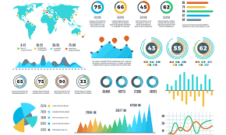
visual representation of the data (eda)

Slide 8
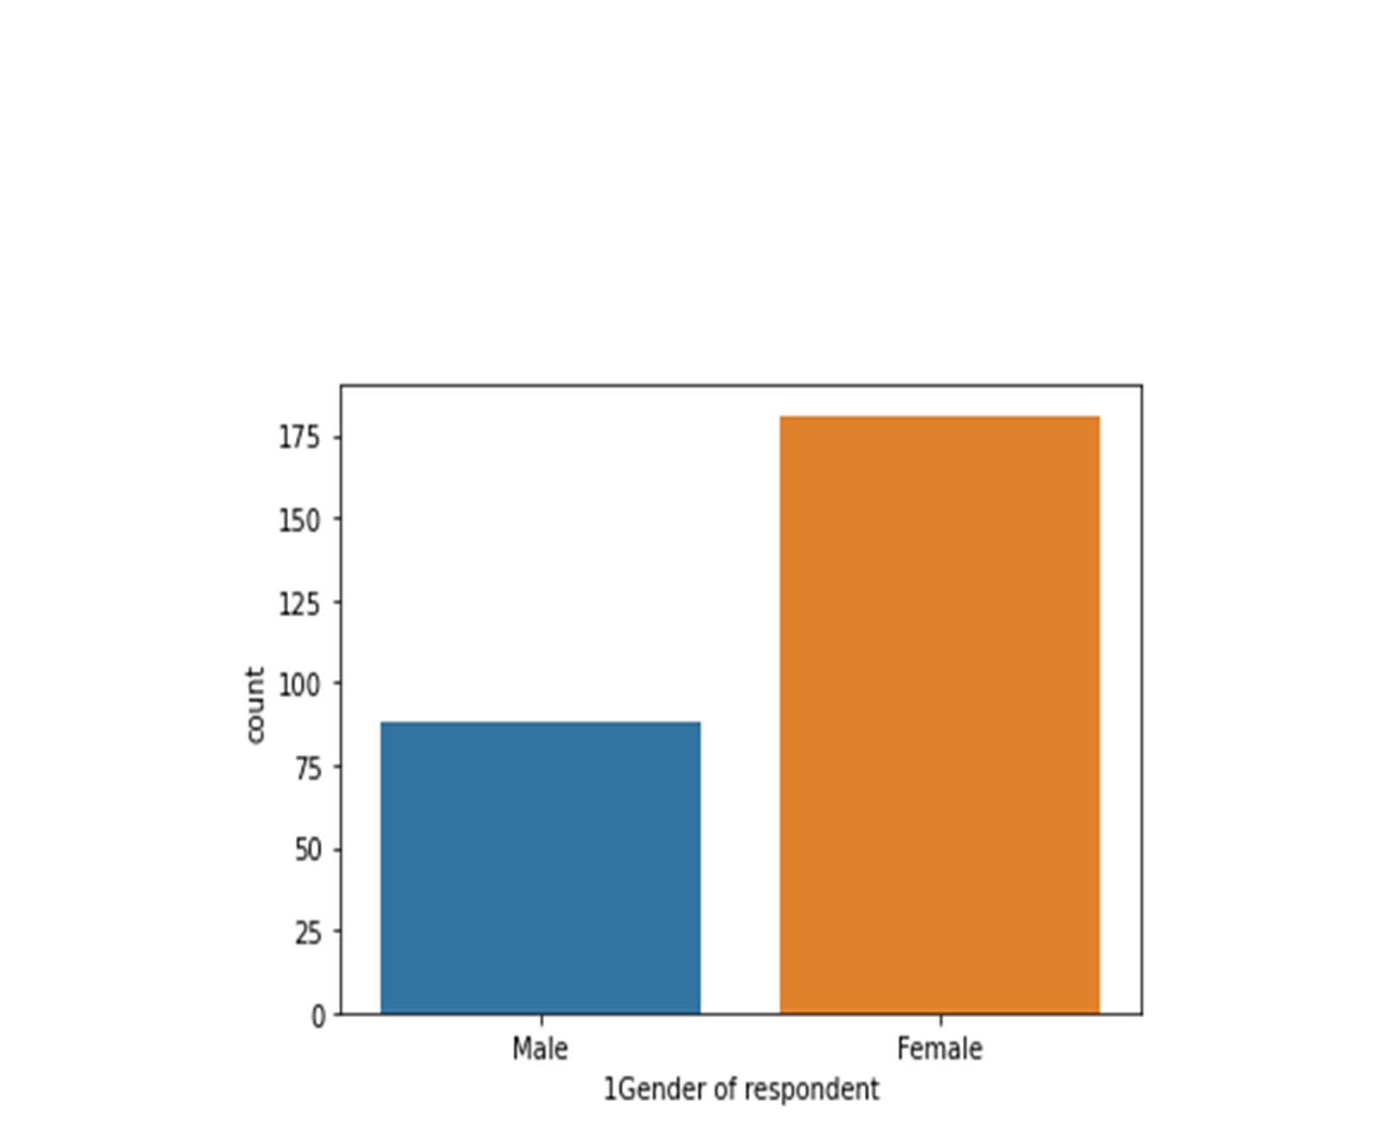
1. Column - Gender of the respondent
This graph tells the gender of the respondent that responded to the review approximately there were 89 male respondent and 180 female respondent.

Slide 9
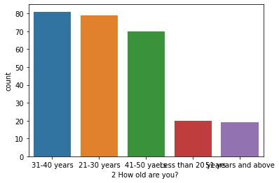
Column -2 Age of the respondent.
This graph tells the age of the respondent that responded to the review 80 of them were in the age group of 31-40 years followed by 77 in the age group of 21-30 years then 69 in the group of 41-50 years then 20 in the age group less than 20 and then 19 in the age group of 51 years and above.

Slide 10
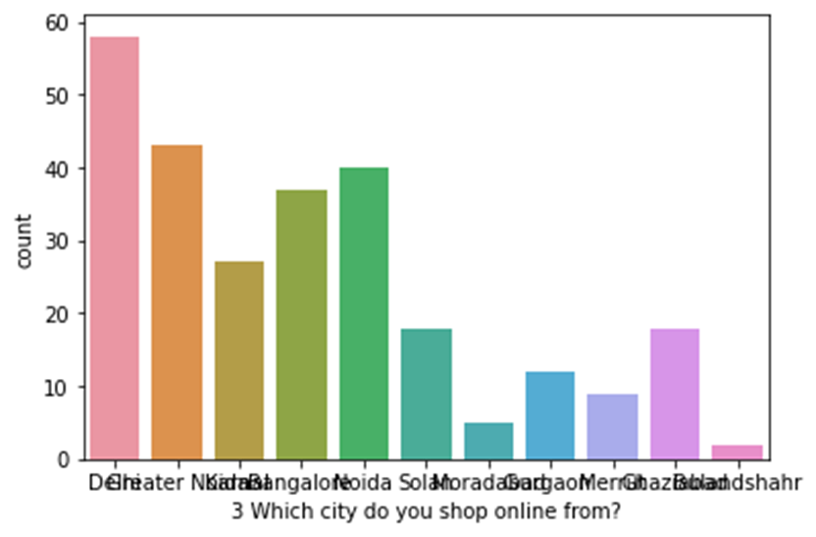
Column-3-Which city do you shop online from?
This graph tells the city of the respondent from where they shop online 56 of them shop from delhi , 43 of them from greater noida, 26 of them from karnal, 36 of them from banglore, 40 of them from noida , 17 of them from solan , 4 of them from moradabad , 13 of them from gurgaon , 10 of them from meerut , 19 of them from ghaziabad , 3 of them from bulandsehar (these are approx figures not the exact ones).

Slide 11
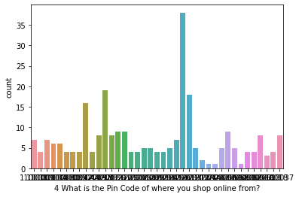
Column-4 What is the Pin Code of where you shop online from?
These are the respondents who have similar pin codes.
35 is the maximum people with same pin codes
There are only 2 people in this survey from respondent which have same pin codes

Slide 12
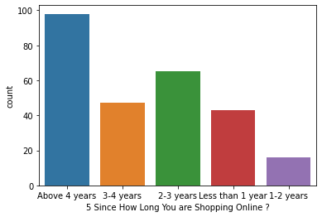
Column-5 Since How Long You are Shopping Online ?
This graph tells since how long they have been shopping online most of them around 97 of them have been shopping online for more than 4 years, then 48 of them in range of 3-4 years , then 69 of them is in the range of 2-3 years , 47 of them in the range of less than 1 year and 18 of them from the range of 1-2 years.

Slide 13
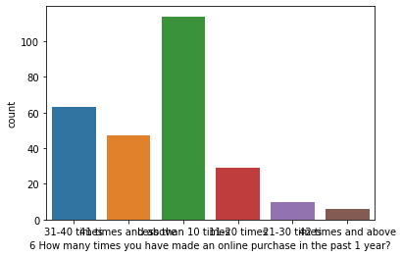
Column-6 How many times you have made an online purchase in the past 1 year?
This graph tells that how mant times a respondent have made an online purchase in past 1 year
most of them more than 100 of them have done purchase less than 10 times in the past year
63 of them 31-40 times
52 of them 41 times around
29 of them 20 times
8 of them 21-30 times
4 of them 2 times and above
(these all are round or appox. figures)

Slide 14
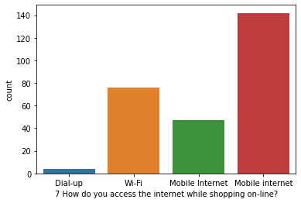
Column-7 How do you access the internet while shopping on-line?
this graph tells how the respondent access the internet for shopping online .
most of them uses mobile internet more than 140 people
78 around respondent using wifi
around 49 using other mobile internet
4 to 5 of them using dial up

Slide 15
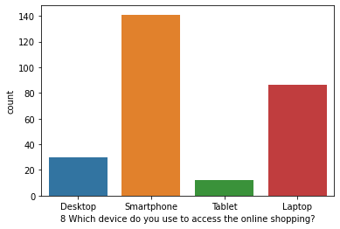
Column-8 Which device do you use to access the online shopping?
this graph tells how many people use what kind of device to do online shopping
28-30 of them uses desktop
most of them around 140 of them uses smartphones
6-9 of them uses tablet
88 of them uses laptop

Slide 16
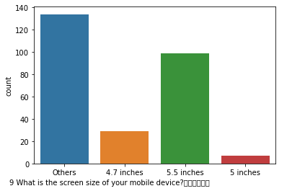
Column-9 What is the screen size of your mobile device?
this tells how many people have what screen size of the smartphones
there are around 30 people that have a screen size of 4.7 inches
then most of them around 105 of them have 5.5 inches
5-8 of them 5 inches
and more than 130 is in others category

Slide 17
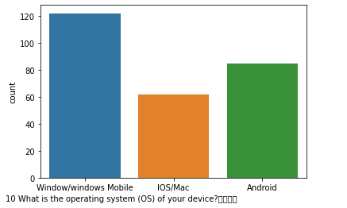
Column-10 What is the operating system (OS) of your device?
This tells how many people have what kind of operating system in there devices which they use for online shopping.
most of them uses windows or windows mobile(around 120 )
around 60 of them ios /mac
around 82 of them android

Slide 18
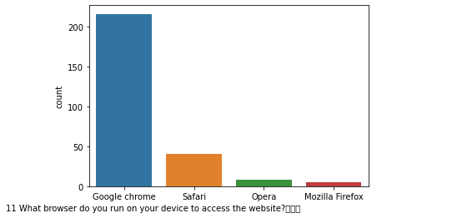
Column-11 What browser do you run on your device to access the website?
this tells that what browser does the people uses for online shopping
more than 200 of them uses google chrome
around 35 of them uses safari
around 8 of them uses opera
around 4 of them uses mozilla firefox

Slide 19
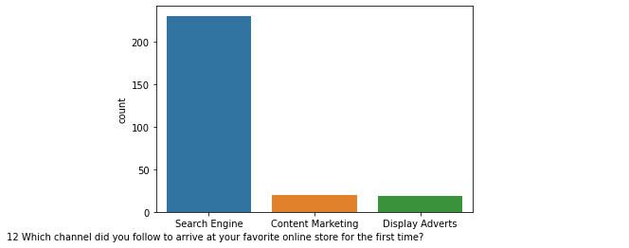
Column-12 Which channel did you follow to arrive at your favorite online store for the first time?
this tells which channel did the respondent used to arrive at the favorite online store for the first time
most of them mean more than approx 239 of them uses search engine
around 15 of them used content marketing and
15 of them display adverts

Slide 20
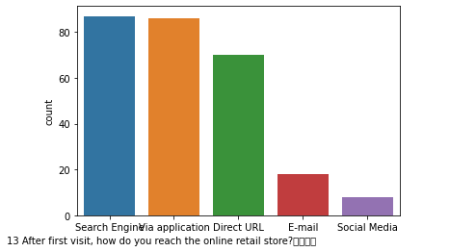
Column-13 After first visit, how do you reach the online retail store?
this tells how the people reach there online store
most of them using search engine (around85)
then followed by application (around83)
then by direct url (around68)
then by e mail (around18)
then by social media (around9)

Slide 21
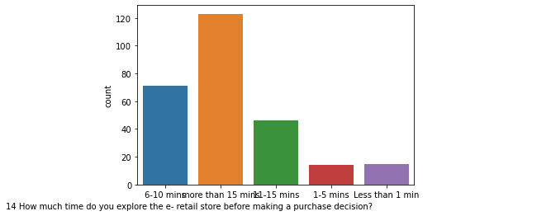
Column-14 How much time do you explore the e- retail store before making a purchase decision?
Before making purchase how much time respondent spends on the e retail store to explore
most of them around more than 15 min
then 6-10 min
then 11-15 min
less than 1 min
1 to 5 min

Slide 22
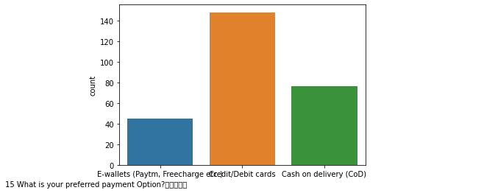
Column-15 What is your preferred payment Option?
This tells that What is your preferred payment Option of the respondent
most of them uses debit cards
then followed by cadh on delivery
then las e wallets

Slide 23
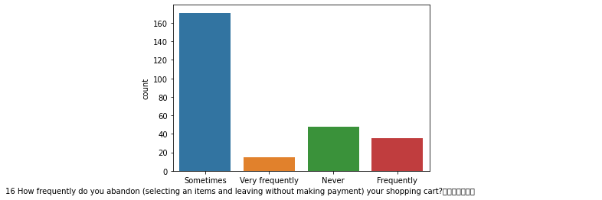
Column-16 How frequently do you abandon (selecting an items and leaving without making payment) your shopping cart?
This graph tell that How frequently do you abandon (selecting an items and leaving without making payment) your shopping cart
most of the people do it sometimes around 170
then around 50 of them never
then 38 approx of them frequently
and 10 around of them very frequently

Slide 24
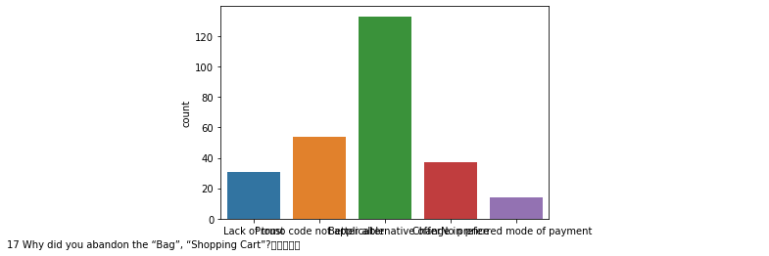
Column-17 Why did you abandon the “Bag”, “Shopping Cart”?
this graph tells that Why did respondent abandon the “Bag”, “Shopping Cart”
most of them due to alternative websites
then code not acceptable
then bag not preferred
then lack of photos
then mode of payment

Slide 25
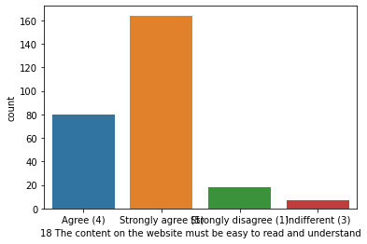
Column-18 The content on the website must be easy to read and understand'
this graph tell that what people say about this statement that The content on the website must be easy to read and understand
most of them strongly agree
then most of them agree
then few of them strongly disagree
then last one different

Slide 26
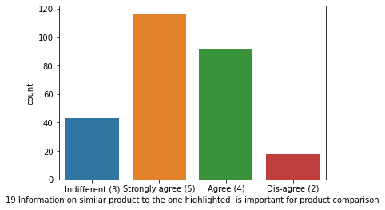
Column-19 Information on similar product to the one highlighted is important for product comparison
this graph tell that what people say about this statement that Information on similar product to the one highlighted is important for product comparison
most of them strongly agree around 118 of them
then most of them agree around 90 of them
ten few of them indifferent around 43 of them
then last one disagree around 17 of them

Slide 27
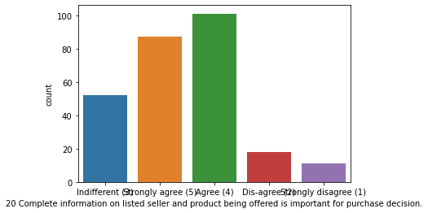
Column-20 Complete information on listed seller and product being offered is important for purchase decision.
this graph tell that what people say about this statement that Complete information on listed seller and product being offered is important for purchase decision.
most of them agree around 100 of them
then most of them strongly agree around 87 of them
then few of them indifferent around 53 of them
then few one disagree around 17 of them
then last strongly disagree around 12 of them

Slide 28
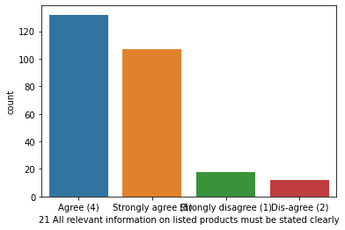
Column-21 All relevant information on listed products must be stated clearly
this graph tell that what people say about this statement that All relevant information on listed products must be stated clearly¶
most of them agree around 128 of them
then most of them strongly agree around 108 of them
then few of them strongly disagree around 16 of them
then last one disagree around 12 of them

Slide 29
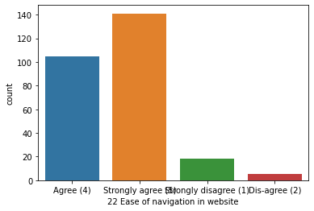
Column-22 Ease of navigation in website
this graph tell that what people say about this statement that Ease of navigation in website
most of them strongly agree around 140 of them
then most of them agree around 104 of them
then few of them strongly disagree around 18 of them
then last one disagree around 7 of them

Slide 30
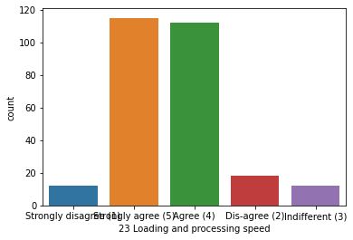
Column-23 Loading and processing speed
this graph tell that what people say about this statement that Loading and processing speed
most of them strongly agree around 118 of them
then most of them agree around 117 of them
then few of them disagree around 19 of them
then second last is strongly disagree around 16 of them
then last one is indifferent around 14

Slide 31
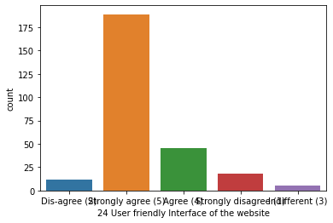
Column24 User friendly Interface of the website
this graph tell that what respondent say about this statement that User friendly Interface of the website
most of them strongly agree around 192 of them
then most of them agree around 45 of them
then few of them strongly disagree around 20 of them
then second last one is disagree around 12 of them
then last one is indifferent 7 of them

Slide 32
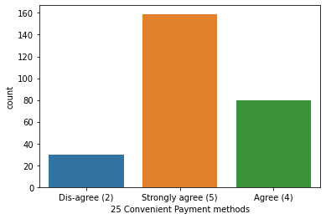
Column-25 Convenient Payment methods
this graph tell that what people say about this statement that Convenient Payment methods
most of them strongly agree around 158 of them
then most of them agree around 79 of them
then last one disagree around 29 of them

Slide 33
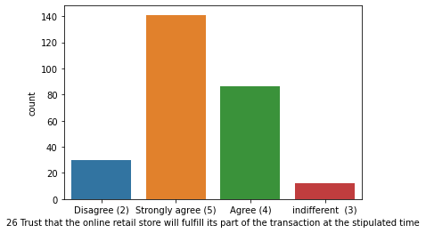
Column-26 Trust that the online retail store will fulfill its part of the transaction at the stipulated time
this graph tell that what people say about this statement that Trust that the online retail store will fulfill its part of the transaction at the stipulated time
most of them strongly agree around 139 of them
then most of them agree around 84 of them
then few of them disagree around 28 of them
then last one indifferent around 15 of them

Slide 34
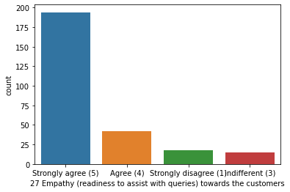
Column-27 Empathy (readiness to assist with queries) towards the customers
this graph tell that what people say about this statement that Empathy (readiness to assist with queries) towards the customers
most of them strongly agree around 193 of them
then most of them agree around 39 of them
then few of them indifferent around 20 of them
then last one disagree around 15 of them

Slide 35
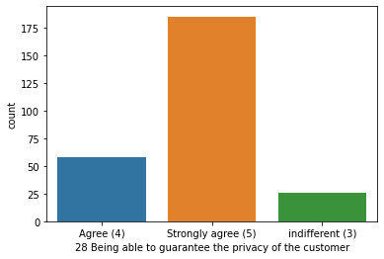
Column-28 Being able to guarantee the privacy of the customer
this graph tell that what people say about this statement that Being able to guarantee the privacy of the customer
most of them strongly agree around 185 of them
then most of them agree around 58 of them
then few of them indifferent around 34 of them

Slide 36
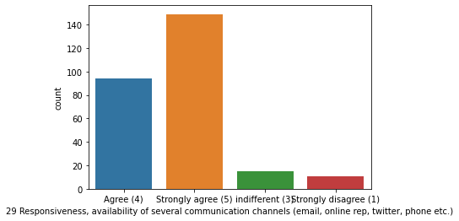
Column-29 Responsiveness, availability of several communication channels (email, online rep, twitter, phone etc.)
this graph tell that what people say about this statement that Responsiveness, availability of several communication channels (email, online rep, twitter, phone etc.)
most of them strongly agree around 150 of them
then most of them agree around 94 of them
then few of them indifferent around 16 of them
then last one is strongly disagree around 9 of them

Slide 37
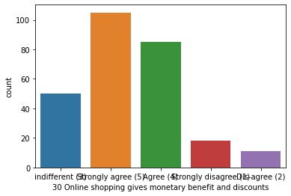
Column-30 Online shopping gives monetary benefit and discounts
this graph tell that what people say about this statement that Online shopping gives monetary benefit and discounts
most of them strongly agree around 107 of them
then most of them agree around 87 of them
then few of them indifferent around 49 of them
then strongly disagree one around 17 of them
last is disagree around 12 of them

Slide 38
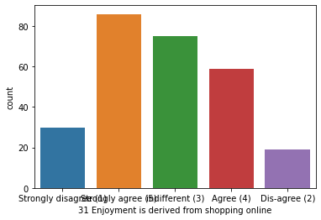
Column-31 Enjoyment is derived from shopping online
this graph tell that what people say about this statement that Enjoyment is derived from shopping online
most of them strongly agree around 87 of them
then most of them indifferent around 77 of them
then few of them agree around 58 of them
then disagree around 18 of them
then last one strongly disagree 28 of them

Slide 39
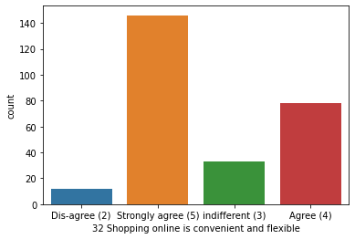
Column-32Shopping online is convenient and flexible
this graph tell that what people say about this statement that Shopping online is convenient and flexible
most of them strongly agree around 144 of them
then most of them agree around 80 of them
then few of them indifferent around 38 of them
then last one disagree around 16 of them

Slide 40
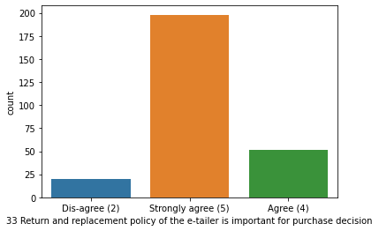
Column-33 Return and replacement policy of the e-tailer is important for purchase decision
this graph tell that what people say about this statement that Return and replacement policy of the e-tailer is important for purchase decision
most of them strongly agree around 197 of them
then most of them agree around 53 of them
then last one disagree around 22 of them

Slide 41
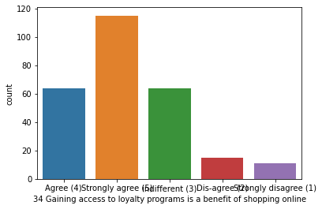
Column-34Gaining access to loyalty programs is a benefit of shopping online
this graph tell that what people say about this statement that Gaining access to loyalty programs is a benefit of shopping online
most of them strongly agree around 116 of them
then same number of them agree and indifferent. around 63 of them
then few of them disagree around 17 of them
then last one strongly disagree around 14 of them

Slide 42
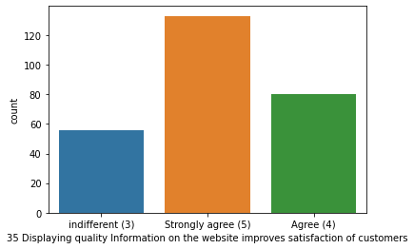
Column-35 Displaying quality Information on the website improves satisfaction of customers
this graph tell that what people say about this statement that Displaying quality Information on the website improves satisfaction of customers
most of them strongly agree around 133 of them
then most of them agree around 80 of them
then few of them indifferent around 57 of them

Slide 43
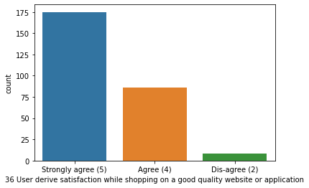
Column-36 User derive satisfaction while shopping on a good quality website or application
this graph tell that what people say about this statement that User derive satisfaction while shopping on a good quality website or application
most of them strongly agree around 174 of them
then most of them agree around 80 of them
then last one disagree around 9 of them

Slide 44
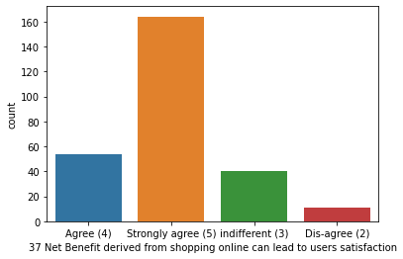
Column-37 Net Benefit derived from shopping online can lead to users satisfaction
this graph tell that what people say about this statement that Net Benefit derived from shopping online can lead to users satisfaction
most of them strongly agree around 163 of them
then most of them agree around 54 of them
then few of them indifferent around 40 of them
then last one disagree around 9 of them

Slide 45
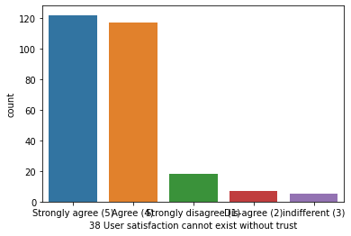
Column-38 User satisfaction cannot exist without trust
this graph tell that what people say about this statement that User satisfaction cannot exist without trust
most of them strongly agree around 120 of them
then most of them agree around 118 of them
then few of them strongly disagree around 18 of them
then comes disagree around 8 of them
then last one is the indifferent around 6 of them

Slide 46
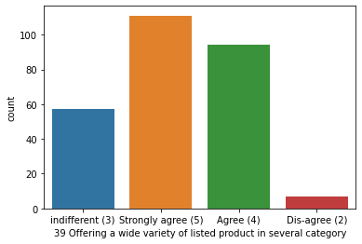
Column-39 Offering a wide variety of listed product in several category
this graph tell that what people say about this statement that Offering a wide variety of listed product in several category
most of them strongly agree around 112 of them
then most of them agree around 96 of them
then is the indifferent around 57 of them
then comes disagree around 8 of them

Slide 47
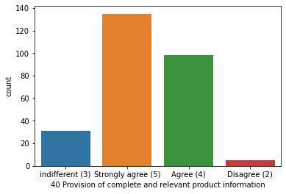
Column-40 Provision of complete and relevant product information
this graph tell that what people say about this statement that Provision of complete and relevant product information
most of them strongly agree around 137 of them
then most of them agree around 99 of them
then is the indifferent around 30 of them
then comes disagree around 6 of them

Slide 48
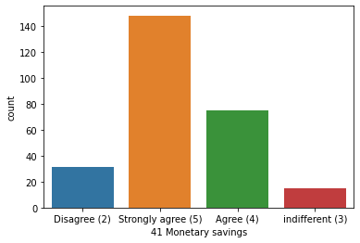
Column-41 Monetary savings
this graph tell that what people say about this statement that Monetary savings
most of them strongly agree around 149 of them
then most of them agree around 70 of them
then is the indifferent around 20 of them
then comes disagree around 30 of them

Slide 49
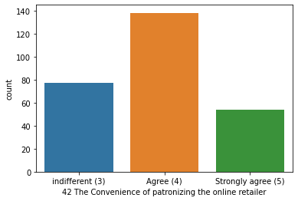
Column-42 The Convenience of patronizing the online retailer
this graph tell that what people say about this statement that The Convenience of patronizing the online retailer
most of them agree around 138 of them
then is the indifferent around 77 of them
then comes strongly agree around 57 of them

Slide 50
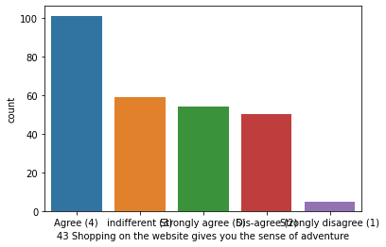
Column-43 Shopping on the website gives you the sense of adventure
this graph tell that what people say about this statement that Shopping on the website gives you the sense of adventure
most of them agree around 100 of them
then most of them strongly agree around 55 of them
then is the indifferent around 58 of them
then comes disagree around 52 of them
then is strongly disagree around 6 of them

Slide 51
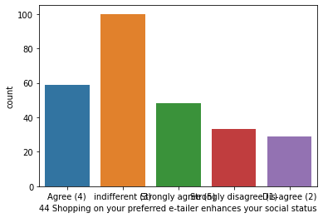
Column-44 Shopping on your preferred e-tailer enhances your social status
this graph tell that what people say about this statement that Shopping on your preferred e-tailer enhances your social status
most of them strongly agree around 53 of them
then most of them agree around 78 of them
then is the indifferent around 97 of them
then comes disagree around 28 of them
then is strongly disagree around 30 of them

Slide 52
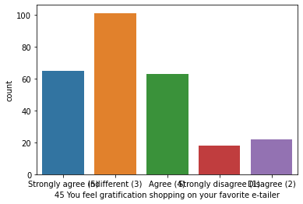
Column-45 You feel gratification shopping on your favorite e-tailer
this graph tell that what people say about this statement that You feel gratification shopping on your favorite e-tailer
most of them strongly agree around 64 of them
then most of them agree around 62 of them
then is the indifferent around 100 of them
then comes disagree around 20 of them
then is strongly disagree 17 of them

Slide 53
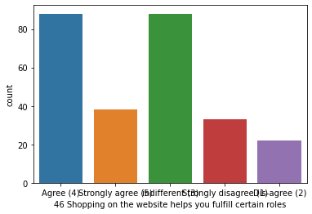
Column-46 Shopping on the website helps you fulfill certain roles
this graph tell that what people say about this statement that Shopping on the website helps you fulfill certain roles
most of them indifferent and agree around 88 of them
then most of them strongly agree around 37 of them
then is the strongly disagree around 32 of them
then comes disagree around 24 of them

Slide 54
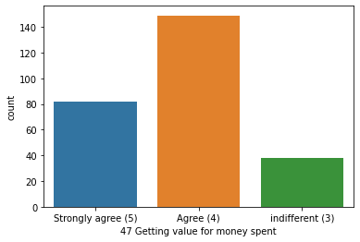
Column-47 Getting value for money spent
this graph tell that what people say about this statement that Getting value for money spent
most of them strongly agree around 80 of them
then most of them agree around 150 of them
then last one is the indifferent around 39 of them

Slide 55
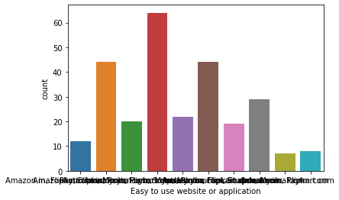
Column-47 Easy to use website or application
this graph shows which website has the most Easy to use website or application
most of the respondent ticked on amazon and flipkart
then amazon , flipkart and paytm
them amazon, flipkart , paytm and myntra
then amazon, flipkart, paytm, mayntra, and snapdeal
then amazon, flipkart, myntra, and snapdeal
then amazon
then flipkart
then paytm.com
then snapdeal
then last myntra

Slide 56
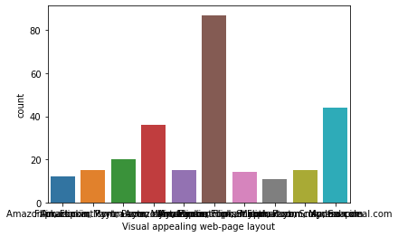
Column-48 Visual appealing web-page layout
this graph shows which website has the most Visual appealing web-page layout
most of the respondent ticked on amazon and flipkart
then amazon , flipkart and myntra
them amazon, flipkart , paytm and myntra
then amazon, flipkart, and paytm
then amazon, flipkart, myntra, and snapdeal
then amazon
then flipkart
then myntra
then snapdeal
then paytm

Slide 57

Column-49 Wild variety of product on offer
this graph shows which website is the most Wild variety of product on offer
most of the respondent ticked on amazon and flipkart
then amazon , flipkart and myntra
them amazon, flipkart , paytm and myntra
then amazon, flipkart, and paytm
then amazon, flipkart, myntra, and snapdeal
then amazon
then flipkart
then snapdeal
then myntra
then paytm

Slide 58

Column-50 Complete, relevant description information of products
this graph shows which website has Complete, relevant description information of products
most of the respondent ticked on amazon and flipkart
then amazon , flipkart and myntra
them amazon, flipkart , paytm and myntra
then amazon, flipkart, and paytm
then amazon, flipkart, myntra, and snapdeal
then amazon
then flipkart
then snapdeal
then myntra
then paytm

Slide 59

Column-51 Fast loading website speed of website and application
this graph shows which website has the Fast loading website speed of website and application
most of the respondent ticked on amazon , flipkart , paytm and myntra
then amazon , flipkart and paytm
them amazon, flipkart and myntra
then amazon, flipkart, and paytm
then amazon,
then paytm
then myntra

Slide 60

Column-52 Reliability of the website or application
this graph shows which website has Reliability of the website or application
most of the respondent ticked on amazon ,flipkart and paytm
then amazon , flipkart , paytm and myntra
them amazon, flipkart , paytm and snapdeal
then amazon, and flipkart
then amazon
then amazon , flipkart , myntra and snapdeal
then paytm
then myntra
then flipkart

Slide 61

Column-53 Quickness to complete purchase
this graph shows which website has the Quickness to complete purchase
most of the respondent ticked on amazon and flipkart
then amazon , flipkart and paytm
them amazon, flipkart and snapdeal
then amazon, flipkart, and paytm
then amazon, flipkart, myntra, and snapdeal
then amazon
then flipkart
then snapdeal
then myntra
then paytm

Slide 62

Column-54 Availability of several payment options
this graph shows which website has Availability of several payment options
most of the respondent ticked on amazon and flipkart
then amazon , flipkart and snapdeal
them amazon, flipkart and paytm
then amazon, flipkart, and myntra
then amazon, flipkart, myntra, and snapdeal
then amazon and paytm
then paytm and myntra
then flipkart
then paytm

Slide 63

Column-55 Speedy order delivery
this graph shows which website has the most Speedy order delivery
most of the respondent ticked on amazon
then amazon , flipkart , snapdeal
them amazon and flipkart
then flipkart
then snapdeal

Slide 64

Column-56 Privacy of customers’ information
this graph shows which has most Privacy of customers’ information
most of the respondent ticked on amazon and flipkart
then amazon , flipkart and myntra
them amazon, flipkart , paytm and myntra
then amazon, flipkart, and paytm
then amazon, flipkart, myntra, and snapdeal
then amazon
then flipkart
then snapdeal
then myntra
then paytm

Slide 65

Column-57 Security of customer financial information
this graph shows which has the Security of customer financial information
most of the respondent ticked on amazon and flipkart
then amazon
them amazon, flipkart , paytm
then amazon and paytm
then amazon and snapdeal
then amazon
then paytm
then myntra

Slide 66

Column-58 Perceived Trustworthiness
this graph shows which has the most Perceived Trustworthiness
most of the respondent ticked on amazon and flipkart
then amazon , flipkart and myntra
them amazon
then flipkart
then amazon, flipkart, snapdeal
then amazon, flipkart and paytm
then myntra
then paytm

Slide 67

Column-59 Presence of online assistance through multi-channel
this graph shows which has Presence of online assistance through multi-channel
most of the respondent ticked on amazon , flipkart and myntra
then amazon , flipkart
them amazon, flipkart , myntra and snapdeal
then amazon
then myntra
then amazon , flipkart, myntra and paytm
then amazon flipkart and sanpdeal
then paytm

Slide 68

Column-60 Longer time to get logged in (promotion, sales period)
this graph shows which has Longer time to get logged in (promotion, sales period)
most of the respondent ticked on amazon and flipkart
then amazon , flipkart and myntra
them amazon, flipkart , paytm and myntra
then amazon, flipkart, and paytm
then amazon, flipkart, myntra, and snapdeal
then amazon
then flipkart
then snapdeal
then myntra
then paytm

Slide 69

Column-61 Longer time in displaying graphics and photos (promotion, sales period)
this graph shows which has Longer time in displaying graphics and photos (promotion, sales period)
most of the respondent ticked on paytm and myntra
then amazon
them myntra
then snapdeal and flipkart
then paytm and snapdeal
then snapdeal
then paytm

Slide 70

Column-62 Late declaration of price (promotion, sales period)
this graph shows which website has Late declaration of price (promotion, sales period)
most of the respondent ticked on myntra
then paytm
them snapdeal
then paytm and myntra
then flipkart
then amazon and paytm
then amazon and snapdeal
then flipkart

Slide 71

Column-63 Longer page loading time (promotion, sales period)
this graph shows which website has Longer page loading time (promotion, sales period)
most of the respondent ticked on paytm
then myntra
them paytm and myntra
then amazon, paytm
then amazon, myntra
then flipkart and amazon
then flipkart and snapdeal

Slide 72

Column-64 Limited mode of payment on most products (promotion, sales period)
this graph shows which website has Limited mode of payment on most products (promotion, sales period)
most of the respondent ticked on snapdeal and amazon
then amazon
them paytm
then amazon and paytm
then flipkart and paytm
then paytm
then flipkart and snapdeal
then myntra and snapdeal

Slide 73

Column-65 Longer delivery period
this graph shows which website takes most Longer delivery period
most of the respondent ticked on paytm
then snapdeal
them flipkart
then amazon
then paytm and snapdeal
then myntra

Slide 74

Column-66 Change in website/Application design
this graph shows Change in website/Application design respondent want
most of the responded flipkart
then amazon and paytm
them paytm
then amazon, flipkart
then myntra
then snapdeal
then myntra

Slide 75

Column-67 Frequent disruption when moving from one page to another
this graph shows which is these have Frequent disruption when moving from one page to another
most of the respondent ticked on amazon
then myntra
then paytm
then snapdeal and myntra
then myntra
then flipkart and amazon
then flipkart
then snapdeal

Slide 76

Column-68 Website is as efficient as before
this graph shows which Website is as efficient as before
most of the respondent ticked on amazon , flipkart , and paytm
then amazon , flipkart
then amazon
then flipkart
then paytm and myntra
then snapdeal and amazon
then paytm
then myntra

Slide 77

Column-69 Which of the Indian online retailer would you recommend to a friend?
this graph shows Which of the Indian online retailer would you recommend to a friend? most
most of the respondent ticked on amazon and flipkart
then amazon
then flipkart
then amazon, flipkart, and myntra
then amazon, flipkart, and paytm
then snapdeal, paytm

Slide 78

Understanding and conclusion
This case study was derived from the responses of the respondents on from Indian e-commerce customers related to E-retail which consist of the factors for customer activation and retention. Most of the people have ticked on amazon and flipkart in the questions asked followed by myntra then paytm and at last snapdeal.

Slide 79

Thank you

